Slide 1
Frequent Pattern Mining

Slide 2
Agenda
Frequent Pattern : market basket analysis
Association Rules
Apriori Algorithm
FP-growth: FP-tree
FP Mining with Vertical Data Format
Lift : Correlation measure

Slide 3
Basic Concepts
Frequent Pattern: a pattern (a set of items, subsequences, substructures, etc.) that occurs frequently in a data set
Goal: finding inherent regularities in data
What products were often purchased together?— Milk and Bread?!
What are the subsequent purchases after buying a PC?
What kinds of DNA are sensitive to this new drug?
Can we automatically classify Web documents?
Applications:
A typical example of frequent itemset mining is market basket analysis.
cross-marketing, catalog design, sale campaign analysis, Web log (click stream) analysis, and DNA sequence analysis.

Slide 4
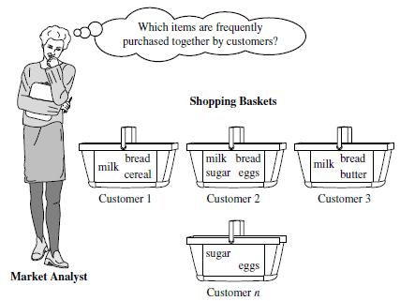
Figure 1 Market basket analysis.
First proposed by Agrawal, Imielinski, and Swami [AIS93] in the context of frequent itemsets and association rule mining (Cited by 25688)

Slide 5
Frequent Patterns
Itemset X = {x₁, …, x_{k}}
Find all the rules X → Y with minimum support and confidence
support, s, probability that a transaction contains X ∪ Y
confidence, c, conditional probability that a transaction having X also contains Y
An itemset X is frequent if X’s support is no less than a minsup threshold
Tid | Items bought
10 | Milk, Bread, Cookies, Juice
20 | Milk, Juice
30 | Milk, Eggs
40 | Bread, Cookies, Coffee
Customer
buys both
Customer
buys Milk
Customer
buys Bread

Slide 6
Association Rules
Find all the rules X → Y with minimum support and confidence threshold
support , s, probability that a transaction contains X ∪ Y
confidence, c, conditional probability that a transaction having X also contains Y
Let Milk → Juice and Bread → Juice
The support of Milk→ Juice = 50% (2/4)
The Conf of Milk → Juice = 66.7% (2/3)
The support of Bread → Juice = 25% ?
The Conf of Bread → Juice = 50% ?
Rules that satisfy both minsup and minconf are called strong rules
Tid | Items bought
10 | Milk, Bread, Cookies, Juice
20 | Milk, Juice
30 | Milk, Eggs
40 | Bread, Cookies, Coffee
Customer
buys both
Customer
buys Milk
Customer
buys Bread

Slide 7
Closed Patterns and Max-Patterns
A long pattern contains a combinatorial number of sub-patterns, e.g., {a₁, …, a₁₀₀} contains (₁₀₀¹) + (₁₀₀²) + … + (₁¹₀⁰₀⁰) = 2¹⁰⁰ – 1 = 1.27*10³⁰ sub-patterns!
Solution: Mine closed patterns and max-patterns instead
An itemset X is closed if X is frequent and there exists no super-pattern Y כ X, with the same support as X
An itemset X is a max-pattern if X is frequent and there exists no frequent super-pattern Y כ X
Closed pattern is a lossless compression of freq. patterns
Reducing the number of patterns and rules

Slide 8
Closed Patterns and Max-Patterns
Example
DB = {<a₁, …, a₁₀₀>, < a₁, …, a₅₀>}
Min_sup=1
What is the set of closed itemset?
<a1, …, a100>: 1
< a1, …, a50>: 2
What is the set of max-pattern?
<a1, …, a100>: 1

Slide 9
Computational Complexity
How many itemsets are potentially to be generated in the worst case?
The number of frequent itemsets to be generated is sensitive to the minsup threshold
When minsup is low, there exist potentially an exponential number of frequent itemsets
The worst case: MN where M: # distinct items, and N: max length of transactions

Slide 10
Apriori: Concepts and Principle
The downward closure property of frequent patterns
Any subset of a frequent itemset must be frequent
If {Milk, Bread, Juice} is frequent, so is {Milk, Bread}
i.e., every transaction having {Milk, Bread, Juice} also contains {Milk, Bread}
Apriori pruning principle: If there is any itemset which is infrequent, its superset should not be generated/tested

Slide 11
Apriori Principle
Initially, scan DB once to get frequent 1-itemset
Generate length (k+1) candidate itemsets from length k frequent itemsets
Test the candidates against DB
Terminate when no frequent or candidate set can be generated

Slide 12
Apriori: Example
Sup_{min} = 2
Itemset | sup
{I1} | 2
{I2} | 3
{I3} | 3
{I4} | 1
{I5} | 3
Database
Itemset | sup
{I1} | 2
{I2} | 3
{I3} | 3
{I5} | 3
L₁
Tid | Items
10 | I1, I3, I4
20 | I2, I3, I5
30 | I1, I2, I3, I5
40 | I2, I5
C₁
1st scan
C₂
Itemset | sup
{I1, I2} | 1
{I1, I3} | 2
{I1, I5} | 1
{I2, I3} | 2
{I2, I5} | 3
{I3, I5} | 2
C₂
Itemset
{I1, I2}
{I1, I3}
{I1, I5}
{I2, I3}
{I2, I5}
{I3, I5}
L₂
Itemset | sup
{I1, I3} | 2
{I2, I3} | 2
{I2, I5} | 3
{I3, I5} | 2
2nd scan
C₃
Itemset
{I2, I3, I5}
3rd scan
L₃
Itemset | sup
{I2, I3, I5} | 2

Slide 13
Apriori Algorithm
C_{k}: Candidate itemset of size k
L_{k} : frequent itemset of size k
L₁ = {frequent items};
for (k = 1; L_{k} !=∅; k++) do begin
C_{k+1} = candidates generated from L_{k};
for each transaction t in database do
increment the count of all candidates in C_{k+1} that are contained in t
L_{k+1} = candidates in C_{k+1} with min_support
end
return ∪_{k} L_{k};

Slide 14
Candidate Generation
How to generate candidates?
Step 1: self-joining L_{k}
Step 2: pruning
Join L_{k} p with L_{k} q, as follows:
insert into C_{k+1}
select {p.item_{i}}_{{1,..,k-1}}, p.item_{k}, q.item_{k}
from L_{k} p, L_{k} q
where {p.item_{i}}_{{1,..k-1} =} {q.item_{i}} _{{1,..k-1}} and p.item_{k} < q.item_{k}

Slide 15
Example of Candidate Generation
Suppose we have the following frequent 3-itemsets and we would like to generate the 4-itemsets candidates
L3={{I1, I2, I3} , {I1, I2, I4}, {I1, I3, I4}, {I1, I3, I5}, {I2,I3,I4}}
Self-joining: L3*L3 gives:
{I1,I2,I3,I4} from {I1, I2, I3} , {I1, I2, I4}, and {I2,I3,I4}
{I1,I3,I4,I5} from {I1, I3, I4} and {I1, I3, I5}
Pruning: {I1,I3,I4,I5} is removed because {I1,I4,I5} is not in L3
C4 = {I1,I2,I3,I4}

Slide 16
Generating Association Rules
Once the frequent itemsets have been found, it is straightforward to generate strong association rules that satisfy:
minimum support
minimum confidence
Relation between support and confidence:
support_count(A∪B)
Confidence(A⇒B) = P(B|A)=
support_count(A)
Support_count(A∪B) is the number of transactions containing the itemsets A ∪ B
Support_count(A) is the number of transactions containing the itemset A.

Slide 17
Generating Association Rules
For each frequent itemset L, generate all non empty subsets of L
For every non empty subset S of L, output the rule:
S ⇒ (L-S)
If (support_count(L)/support_count(S)) >= min_conf

Slide 18
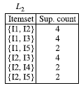

Example
Suppose the frequent Itemset L={I1,I2,I5}
Subsets of L are: {I1,I2},
{I1,I5},{I2,I5},{I1},{I2},{I5}
Association rules :
I1 ∧ I2 ⇒ I5 confidence = 2/4= 50%
I1 ∧ I5 ⇒ I2 confidence=2/2=100%
I2 ∧ I5 ⇒ I1 confidence=2/2=100%
I1 ⇒ I2 ∧ I5 confidence=2/6=33%
I2 ⇒ I1 ∧ I5 confidence=2/7=29%
I5 ⇒ I2 ∧ I2 confidence=2/2=100%
If the minimum confidence =70%
Transactional Database
TID | List of item IDS
T100 | I1,I2,I5
T200 | I2,I4
T300 | I2,I3
T400 | I1,I2,I4
T500 | I1,I3
T600 | I2,I3
T700 | I1,I3
T800 | I1,I2,I3,I5
T900 | I1,I2,I3

Slide 19
Improving the Efficiency of Apriori
Major computational challenges
Huge number of candidates
Multiple scans of transaction database
Tedious workload of support counting for candidates
Improving Apriori: general ideas
Hash-based technique
Transaction reduction
Partitioning
Sampling

Slide 20
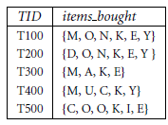
Exercises
A database has five transactions. Let min sup D 60% and min conf D 80%.
Find all frequent itemsets using Apriori.
List all the strong association rules.

Slide 21
FP-growth: Frequent Pattern-Growth
Adopts a divide and conquer strategy
Compress the database representing frequent items into a frequent –pattern tree or FP-tree
Retains the itemset association information
Divid the compressed database into a set of conditional databases, each associated with one frequent item
Mine each such databases separately

Slide 22
Example: FP-growth
The first scan of data is the same as Apriori
Derive the set of frequent 1-itemsets
Let min-sup=2
Generate a set of ordered items
Transactional Database
TID | List of item IDS
T100 | I1,I2,I5
T200 | I2,I4
T300 | I2,I3
T400 | I1,I2,I4
T500 | I1,I3
T600 | I2,I3
T700 | I1,I3
T800 | I1,I2,I3,I5
T900 | I1,I2,I3
Item ID | Support count
I2 | 7
I1 | 6
I3 | 6
I4 | 2
I5 | 2

Slide 23
Construct the FP-Tree
Transactional Database
TID | Items | TID | Items | TID | Items
T100 | I1,I2,I5 | T400 | I1,I2,I4 | T700 | I1,I3
T200 | I2,I4 | T500 | I1,I3 | T800 | I1,I2,I3,I5
T300 | I2,I3 | T600 | I2,I3 | T900 | I1,I2,I3
- Create a branch for each transaction
- Items in each transaction are processed in order
1- Order the items T100: {I2,I1,I5}
2- Construct the first branch:
<I2:1>, <I1:1>,<I5:1>
null
Item ID | Support count
I2 | 7
I1 | 6
I3 | 6
I4 | 2
I5 | 2
I2:1
I1:1
I5:1

Slide 24
Construct the FP-Tree
Transactional Database
TID | Items | TID | Items | TID | Items
T100 | I1,I2,I5 | T400 | I1,I2,I4 | T700 | I1,I3
T200 | I2,I4 | T500 | I1,I3 | T800 | I1,I2,I3,I5
T300 | I2,I3 | T600 | I2,I3 | T900 | I1,I2,I3
- Create a branch for each transaction
- Items in each transaction are processed in order
1- Order the items T200: {I2,I4}
2- Construct the second branch:
<I2:1>, <I4:1>
null
Item ID | Support count
I2 | 7
I1 | 6
I3 | 6
I4 | 2
I5 | 2
I2:2
I2:1
I1:1
I4:1
I5:1

Slide 25
Construct the FP-Tree
Transactional Database
TID | Items | TID | Items | TID | Items
T100 | I1,I2,I5 | T400 | I1,I2,I4 | T700 | I1,I3
T200 | I2,I4 | T500 | I1,I3 | T800 | I1,I2,I3,I5
T300 | I2,I3 | T600 | I2,I3 | T900 | I1,I2,I3
- Create a branch for each transaction
- Items in each transaction are processed in order
1- Order the items T300: {I2,I3}
2- Construct the third branch:
<I2:2>, <I3:1>
null
Item ID | Support count
I2 | 7
I1 | 6
I3 | 6
I4 | 2
I5 | 2
I2:2
I2:3
I1:1
I4:1
I3:1
I5:1

Slide 26
Construct the FP-Tree
Transactional Database
TID | Items | TID | Items | TID | Items
T100 | I1,I2,I5 | T400 | I1,I2,I4 | T700 | I1,I3
T200 | I2,I4 | T500 | I1,I3 | T800 | I1,I2,I3,I5
T300 | I2,I3 | T600 | I2,I3 | T900 | I1,I2,I3
- Create a branch for each transaction
- Items in each transaction are processed in order
1- Order the items T400: {I2,I1,I4}
2- Construct the fourth branch:
<I2:3>, <I1:1>,<I4:1>
null
Item ID | Support count
I2 | 7
I1 | 6
I3 | 6
I4 | 2
I5 | 2
I2:4
I2:3
I1:2
I4:1
I1:1
I3:1
I5:1
I4:1

Slide 27
Construct the FP-Tree
Transactional Database
TID | Items | TID | Items | TID | Items
T100 | I1,I2,I5 | T400 | I1,I2,I4 | T700 | I1,I3
T200 | I2,I4 | T500 | I1,I3 | T800 | I1,I2,I3,I5
T300 | I2,I3 | T600 | I2,I3 | T900 | I1,I2,I3
- Create a branch for each transaction
- Items in each transaction are processed in order
1- Order the items T400: {I1,I3}
2- Construct the fifth branch:
<I1:1>, <I3:1>
null
Item ID | Support count
I2 | 7
I1 | 6
I3 | 6
I4 | 2
I5 | 2
I1:1
I2:4
I1:2
I4:1
I3:1
I3:1
I5:1
I4:1

Slide 28
Construct the FP-Tree
Transactional Database
TID | Items | TID | Items | TID | Items
T100 | I1,I2,I5 | T400 | I1,I2,I4 | T700 | I1,I3
T200 | I2,I4 | T500 | I1,I3 | T800 | I1,I2,I3,I5
T300 | I2,I3 | T600 | I2,I3 | T900 | I1,I2,I3
null
I2:7
I1:2
Item ID | Support count
I2 | 7
I1 | 6
I3 | 6
I4 | 2
I5 | 2
I1:4
I4:1
I3:2
I3:2
I5:1
I4:1
When a branch of a transaction is added, the count for each node along a common prefix is incremented by 1
I3:2
I5:1

Slide 29
Construct the FP-Tree
null
I2:7
I1:2
Item ID | Support count
I2 | 7
I1 | 6
I3 | 6
I4 | 2
I5 | 2
I1:4
I4:1
I3:2
I3:2
I5:1
I4:1
I3:2
I5:1
The problem of mining frequent patterns in databases is transformed to that of mining the FP-tree

Slide 30
Construct the FP-Tree
null
I2:7
I1:2
Item ID | Support count
I2 | 7
I1 | 6
I3 | 6
I4 | 2
I5 | 2
I1:4
I4:1
I3:2
I3:2
I5:1
I4:1
I3:2
I5:1
-Occurrences of I5: <I2,I1,I5> and <I2,I1,I3,I5>
-Two prefix Paths <I2, I1: 1> and <I2,I1,I3: 1>
-Conditional FP tree contains only <I2: 2, I1: 2>, I3 is not considered because its support count of 1 is less than the minimum support count.
-Frequent patterns {I2,I5:2}, {I1,I5:2},{I2,I1,I5:2}

Slide 31
Construct the FP-Tree
null
I2:7
I1:2
Item ID
Support count
I2
7
I1:4
I4:1
I1
6
I3:2
I3:2
I3
6
I5:1
I4
2
I4:1
I5
2
I3:2
I5:1
TID | Conditional Pattern Base | Conditional FP-tree
I5 | {{I2,I1:1},{I2,I1,I3:1}} | <I2:2,I1:2>
I4 | {{I2,I1:1},{I2,1}} | <I2:2>
I3 | {{I2,I1:2},{I2:2}, {I1:2}} | <I2:4,I1:2>,<I1:2>
I1 | {I2,4} | <I2:4>

Slide 32
Construct the FP-Tree
null
I2:7
I1:2
Item ID
Support count
I2
7
I1:4
I4:1
I1
6
I3:2
I3:2
I3
6
I5:1
I4
2
I4:1
I5
2
I3:2
I5:1
TID | Conditional FP-tree | Frequent Patterns Generated
I5 | <I2:2,I1:2> | {I2,I5:2}, {I1,I5:2},{I2,I1,I5:2}
I4 | <I2:2> | {I2,I4:2}
I3 | <I2:4,I1:2>,<I1:2> | {I2,I3:4},{I1,I3:4},{I2,I1,I3:2}
I1 | <I2:4> | {I2,I1:4}

Slide 33
FP-growth properties
FP-growth transforms the problem of finding long frequent patterns to searching for shorter once recursively and concatenating the suffix
It uses the least frequent suffix offering a good selectivity
It reduces the search cost
If the tree does not fit into main memory, partition the database
Efficient and scalable for mining both long and short frequent patterns

Slide 34
FP Mining with Vertical Data Format
Both Apriori and FP-growth use horizontal data format
Alternatively data can also be
represented in vertical format
TID | List of item IDS
T100 | I1,I2,I5
T200 | I2,I4
T300 | I2,I3
T400 | I1,I2,I4
T500 | I1,I3
T600 | I2,I3
T700 | I1,I3
T800 | I1,I2,I3,I5
T900 | I1,I2,I3
itemset | TID_set
I1 | {T100,T400,T500,T700,T800,T900}
I2 | {T100,T200,T300,T400,T600,T800,T900}
I3 | {T300,T500,T600,T700,T800,T900}
I4 | {T200,T400}
I5 | {T100,T800}

Slide 35
Example
Transform the horizontally formatted data to the vertical format by scanning the database once
The support count of an itemset is simply the length of the TID_set of the itemset
TID | List of item IDS
T100 | I1,I2,I5
T200 | I2,I4
T300 | I2,I3
T400 | I1,I2,I4
T500 | I1,I3
T600 | I2,I3
T700 | I1,I3
T800 | I1,I2,I3,I5
T900 | I1,I2,I3
itemset | TID_set
I1 | {T100,T400,T500,T700,T800,T900}
I2 | {T100,T200,T300,T400,T600,T800,T900}
I3 | {T300,T500,T600,T700,T800,T900}
I4 | {T200,T400}
I5 | {T100,T800}

Slide 36
Example …
Frequent 1-itemsets in vertical format
itemset | TID_set
I1 | {T100,T400,T500,T700,T800,T900}
I2 | {T100,T200,T300,T400,T600,T800,T900}
I3 | {T300,T500,T600,T700,T800,T900}
I4 | {T200,T400}
I5 | {T100,T800}
min_sup=2
The frequent k-itemsets can be used to construct the candidate (k+1)-itemsets based on the Apriori property
Frequent 2-itemsets in vertical format
itemset | TID_set
{I1,I2} | {T100,T400,T800,T900}
{I1,I3} | {T500,T700,T800,T900}
{I1,I4} | {T400}
{I1,I5} | {T100,T800}
{I2,I3} | {T300,T600,T800,T900}
{I2,I4} | {T200,T400}
{I2,I5} | {T100,T800}
{I3,I5} | {T800}

Slide 37
Example …
Frequent 3-itemsets in vertical format
itemset | TID_set
{I1,I2,I3} | {T800,T900}
{I1,I2,I5} | {T100,T800}
min_sup=2
This process repeats, with k incremented by 1 each time, until no frequent items or no candidate itemsets can be found
Properties of mining with vertical data format
Take the advantage of the Apriori property in the generation of candidate (k+1)-itemset from k-itemsets
No need to scan the database to find the support of (k+1) itemsets, for k>=1
The TID_set of each k-itemset carries the complete information required for counting such support
The TID-sets can be quite long, hence expensive to manipulate

Slide 38
Strong Rules Are Not Necessarily Interesting
Whether a rule is interesting or not can be assessed either subjectively or objectively
Objective interestingness measures can be used as one step toward the goal of finding interesting rules for the user
Example of a misleading “strong” association rule
Analyze transactions of AllElectronics data about computer games and videos
Of the 10,000 transactions analyzed
6,000 of the transactions include computer games
7,500 of the transactions include videos
4,000 of the transactions include both
Suppose that min_sup=30% and min_confidence=60%
The following association rule is discovered:
Buys(X, “computer games”) ⇒ buys(X, “videos”)[support =40%, confidence=66%]

Slide 39
Strong Rules Are Not Necessarily Interesting
Buys(X, “computer games”) ⇒ buys(X, “videos”)[support 40%, confidence=66%]
This rule is strong but it is misleading
The probability of purchasing videos is 75% which is even larger than 66%
In fact computer games and videos are negatively associated because the purchase of one of these items actually decreases the likelihood of purchasing the other
The confidence of a rule A ⇒ B can be deceiving
It is only an estimate of the conditional probability of itemset B given itemset A.
It does not measure the real strength of the correlation implication between A and B
Need to use Correlation Analysis

Slide 40
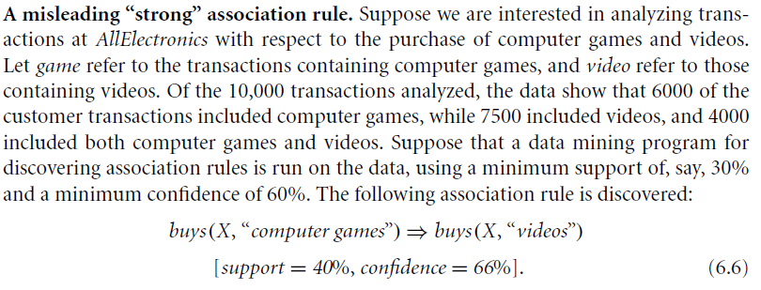
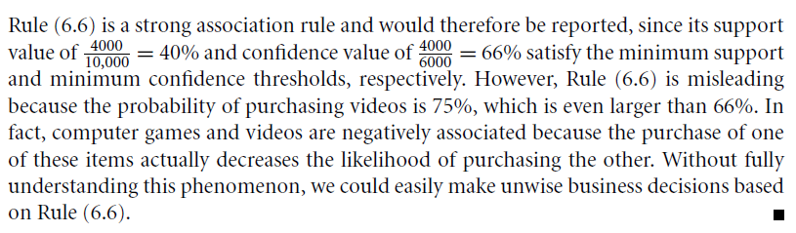
From Association to Correlation Analysis

Slide 41
From Association to Correlation Analysis
Use Lift, a simple correlation measure
The occurrence of itemset A is independent of the occurrence of itemset B if P(A∪B)=P(A)P(B), otherwise itemsets A and B are dependent and correlated as events
The lift between the occurences of A and B is given by
Lift(A,B)=P(A∪B)/P(A)P(B)
If > 1, then A and B are positively correlated (the occurrence of one implies the occurrence of the other)
If <1, then A and B are negatively correlated
If =1, then A and B are independent
Example: P({game, video})=0.4/(0.60 × 0.75)=0.89

Slide 42
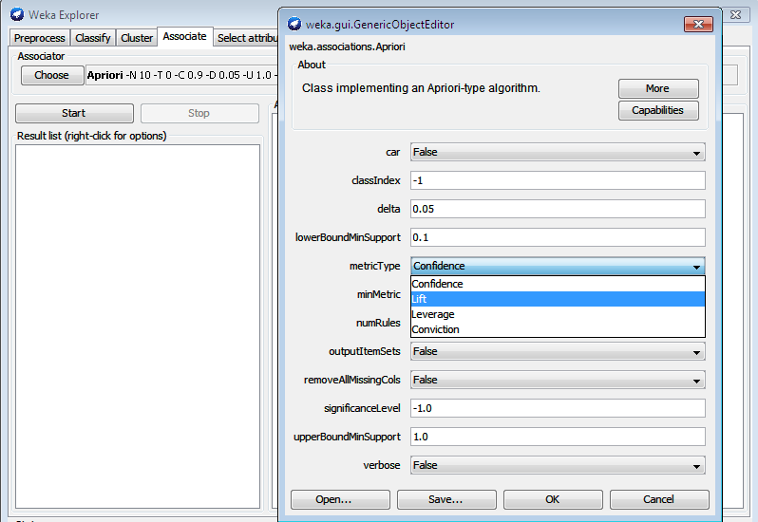

Slide 43
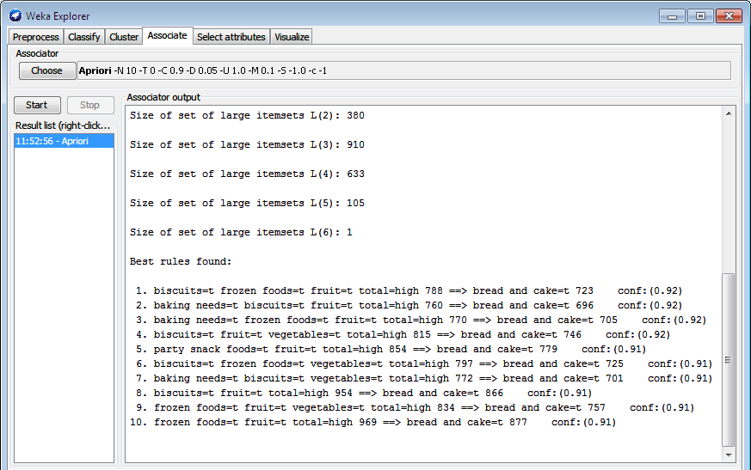

Slide 44
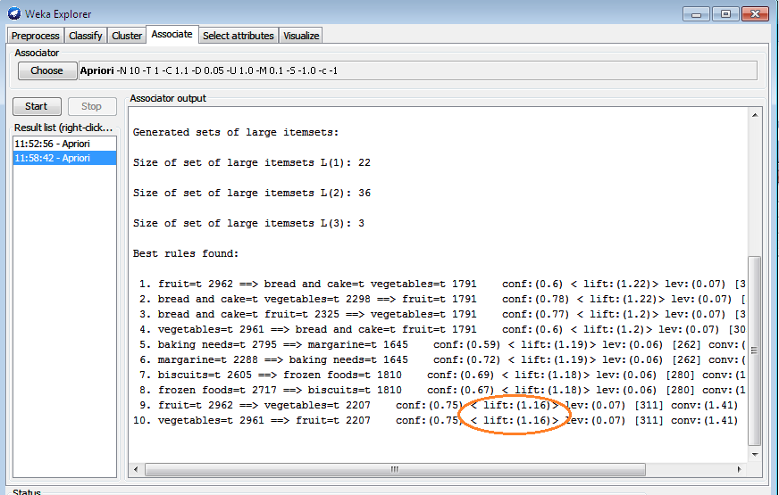

Slide 45
Summary
Basic Concepts: association rules, support-confident framework, closed and max patterns
Scalable frequent pattern mining methods
Apriori (Candidate generation & test)
Pattern-Growth Approach(FPgrowth)
Vertical format approach
Interesting Patterns
Correlation analysis

